Slide 1



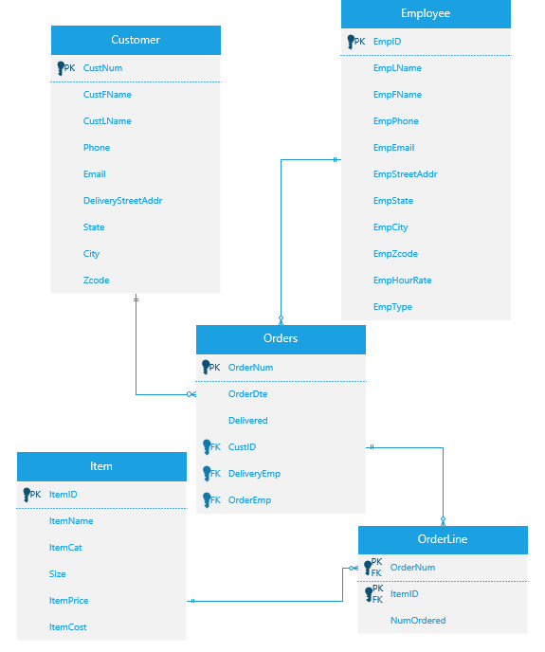
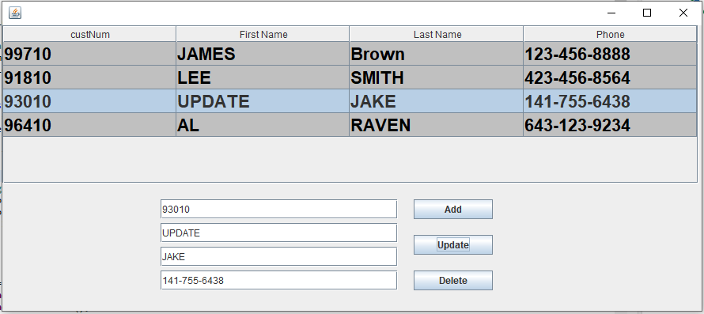
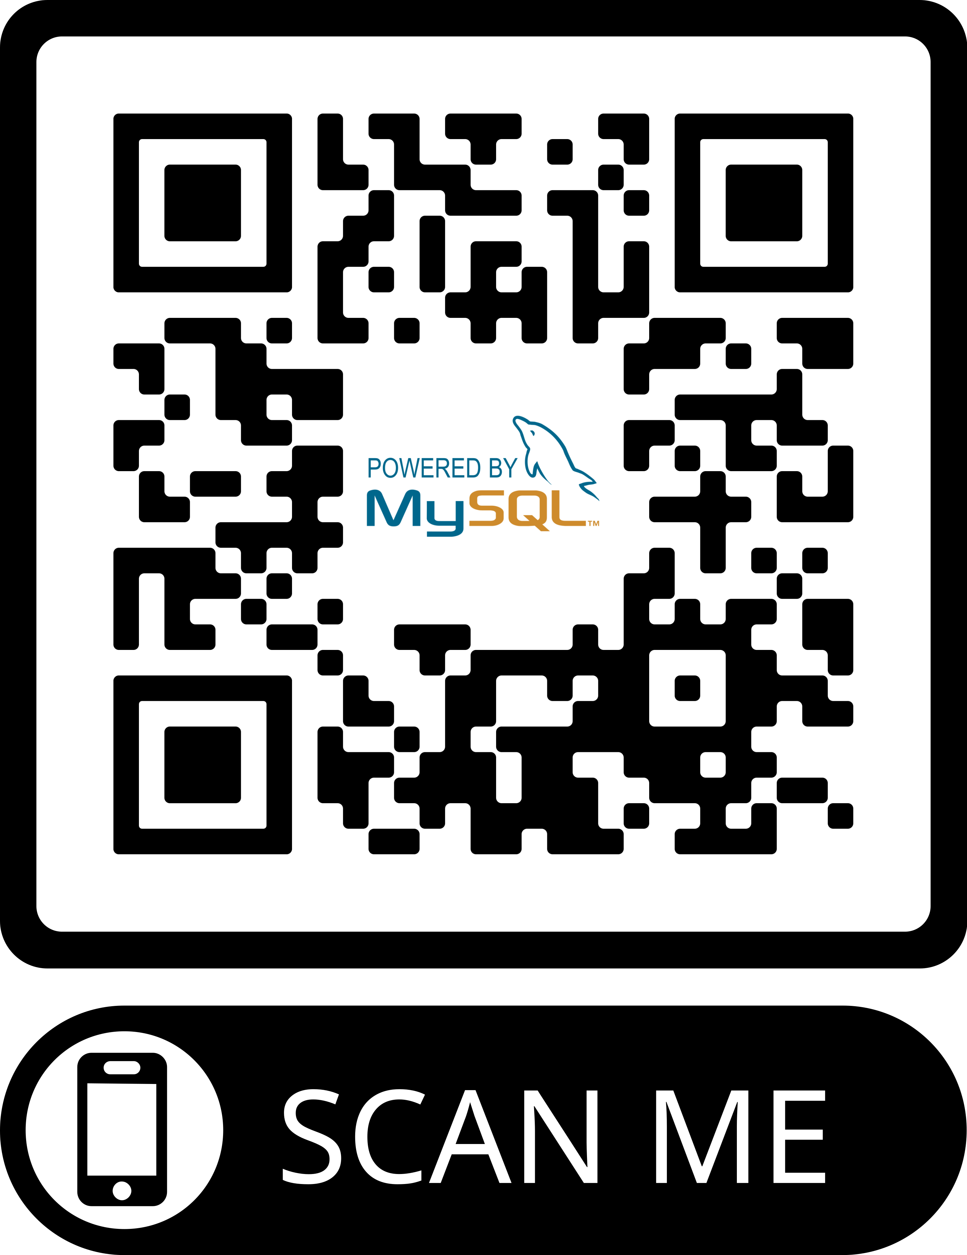
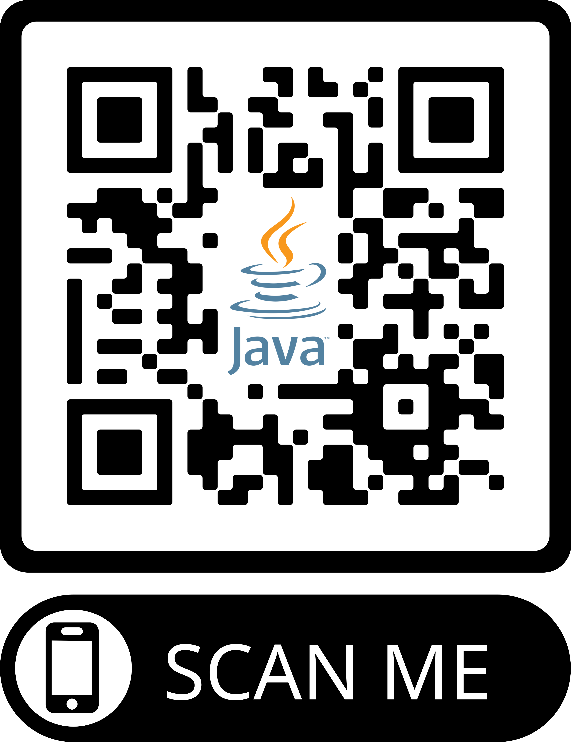
PIZZACO Database Managment Software
Developed by Aryan Merchant, Yvan Ngah
Overview
Design Concepts
Conclusion and Future Direction
Pizzaco currently uses a paper-based record system, which may lead to several challenges such as difficulties in tracking customer orders and inaccurate inventory management. Additionally, this system restricts the scalability of the database, highlighting the need for a more robust and efficient database system. John has sought out a team of database architects to design a system that works around his current business model.
MySQL
MongoDB
Oracle Database
MS Access
The team decided to use MySQL and Java to develop the database and software, based on their flexibility and cost-effectiveness for the Pizzaco database.
The creation of a centralized and secure database system for PIZZACO will enable the store to improve its efficiency, maintain accurate records of customer orders, and ultimately result in cost savings and increased profitability.
Future direction:
As John's business expands, he could consider incorporating an inventory and supplier table into his database system, allowing him to streamline data and avoid redundancy.
To help secure the database, John could implement security measures such as password protection, user access control, data encryption, regular data backups, limited access to authorized personnel, and a system of regular password updates.
John could improve the user interface by creating a user-friendly design with clear instructions for data entry and retrieval, incorporating graphical representations of data, and offering options for customization and personalization.
Java
Python
R
PHP
Objective
ERD of PIZZACO Database
The objective of this project is to develop a centralized and secure database system for PIZZACO that efficiently manages customer orders, reduces manual efforts, maintains accurate records, and ultimately results in cost savings and increased profitability.
Methodology (DDL)
GUI Software of The PIZZACO Database
Customer(CustNum, CustFName, CustLName, Phone, Email, DeliveryStreetAddr, State, City, ZCode)
Employee(EmpID, EmpLName, EmpFName, EmpPhone, EmpEmail, EmpStreetAddr, EmpState, EmpCity, EmpZCode, EmpType, EmpHourRate)
Orders(OrderNum, OrderDte, Delivered, CustID, DeliveryEmp, OrderEmp)
FK: CustID → Customer
DeliveryEmp → Employee
OrderEmp → Employee
Item(ItemID, ItemName, ItemCat, Size, ItemCost, ItemPrice)
OrderLine(OrderNum, ItemID, NumOrdered)
FK: OrderID → Orders
ItemID → Item
Scan for
Source
Code!

